Slide 1
Session 3. Device Programming & Management for VT/VF
How to Set The ICD Parameters, How to Avoid Unnecessary or
Inappropriate Treatment
Lee Ji Hyun
Seoul National University Bundang Hospital

Slide 2
Tachycardia detection
Underdetection of VF was a main concern in early ICD era.
→ Rapid tachycardia detection and shortest possible time to initial therapy
Initial generations of ICD did not record and save electrogram.
With the advent and dominance of primary prevention indications, avoidable shocks assumed a relatively larger proportion of total therapy.
Heart Rhythm 2016;13:e50–e86

Slide 3
Inappropriate therapy can lead to
Pain
Anxiety
Depression
Impaired QOL
Pro-arrhythmia
Increased mortality
Ann Noninvasive Electrocardiol 2012;17:176–185

Slide 4
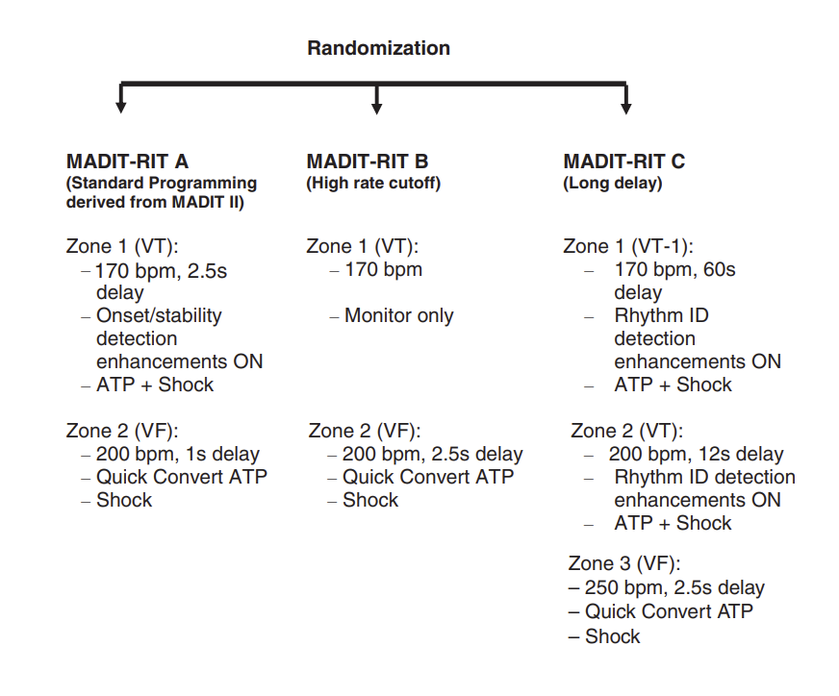
MADIT RIT (sponsored by : Boston Scientific)
Ann Noninvasive Electrocardiol 2012;17:176–185

Slide 5
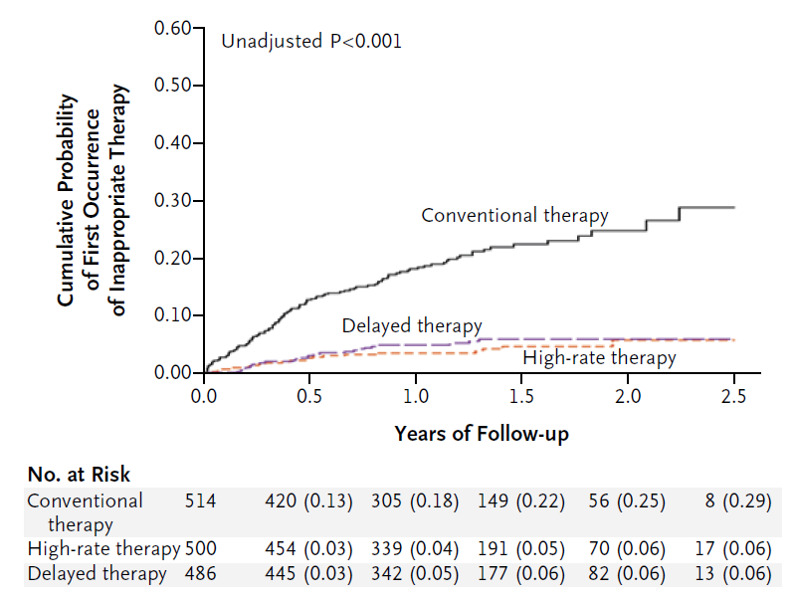
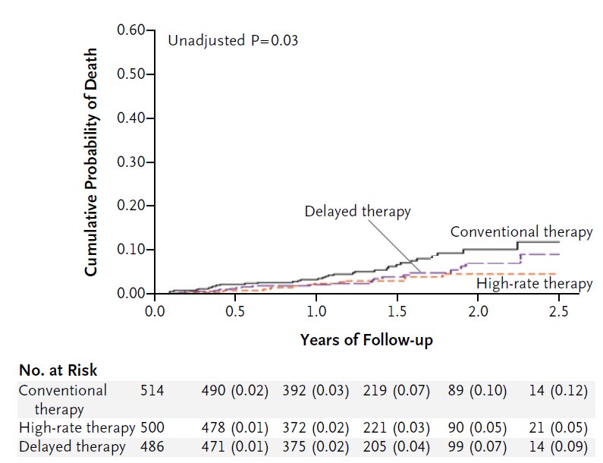
MADIT RIT (ICD: Boston Scientific)
N Engl J Med 2012;367:2275-83.

Slide 6
ADVANCE III (sponsored by Medtronic)
NID: numbers of interval to detect
Randomization
ICD eligible patients (primary and secondary prevention)
Intervention (n=948)
VT zone (150~187 bpm): monitor
VF zone (≥188 bpm): 30/40 intervals
ATP + Shock
Control (n=954)
VT zone (150-187 bpm): monitor
VF zone (≥188 bpm): 18/24 intervals
ATP + Shock
JAMA. 2013;309:1903-11.

Slide 7
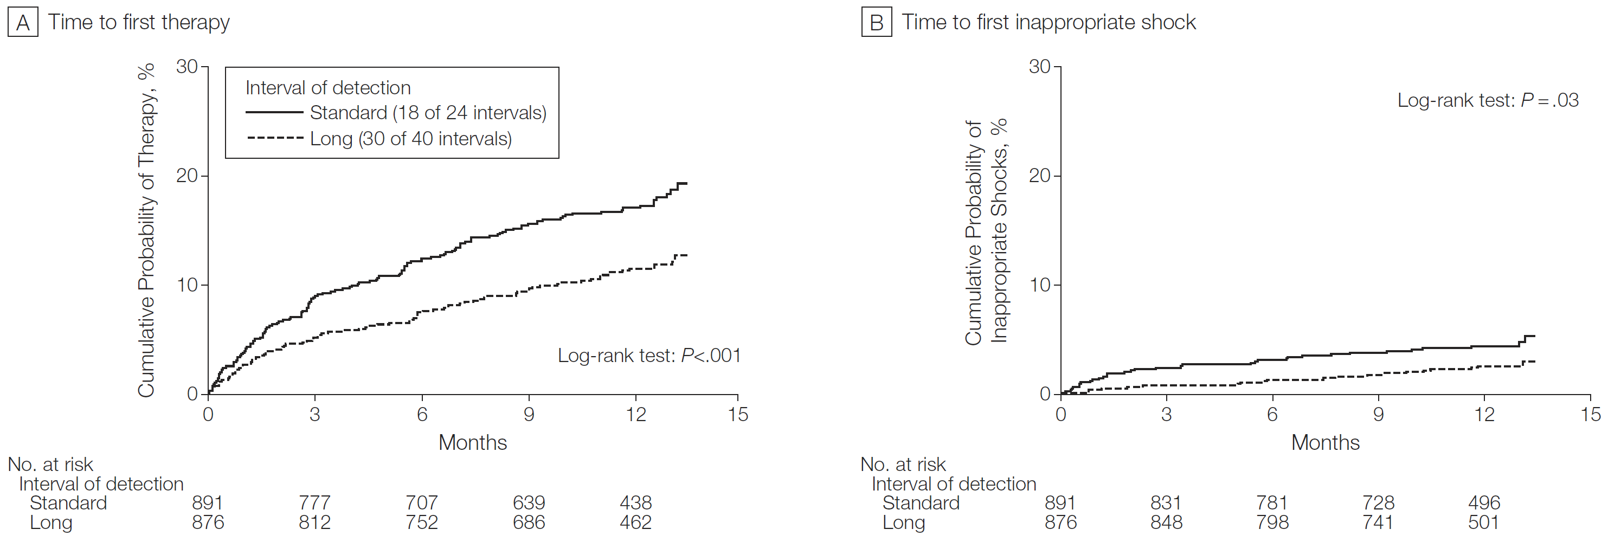
ADVANCE III (Medtronic)
JAMA. 2013;309:1903-11.

Slide 8
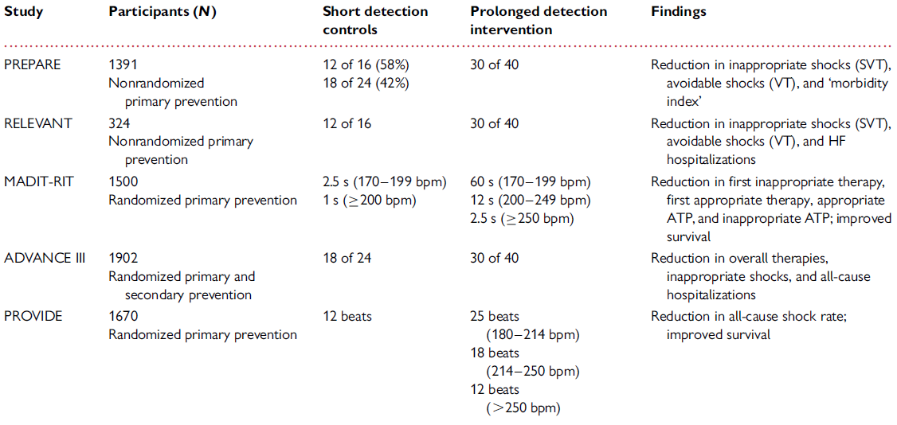
Short vs Long detection interval
Europace 2016;18:159–183.

Slide 9
SVT discriminator component
Rejection of sinus tachycardia by onset (gradual acceleration vs abrupt onset)
- 빈맥 시작 단계에 1회만 적용 가능하며, 잘못 판단했을 때 수정할 수 없음.
Interval stability (AF vs monomorphic VT)
- polymorphic VT 나 monomorphic VT에도 interval irregularity를 보일 수 있음.
V rate > A rate / AV dissociation
Ventricular electrogram morphology discriminator
- Aberrant conduction 을 구분할 수 없고, template 과 유사한 모양의 VT도 나타날 수 있음.
Europace 2016;18:159–183.

Slide 10
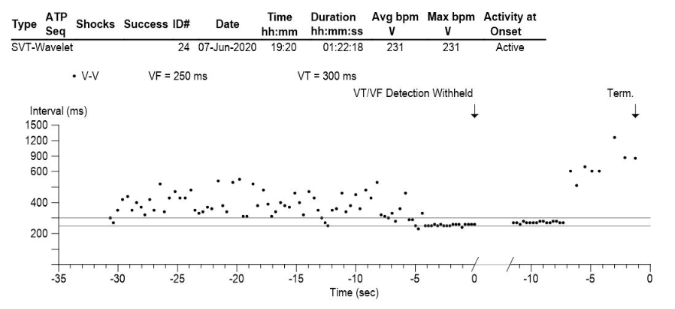
80/M, ischemic CMP, s/p single chamber ICD

Slide 11
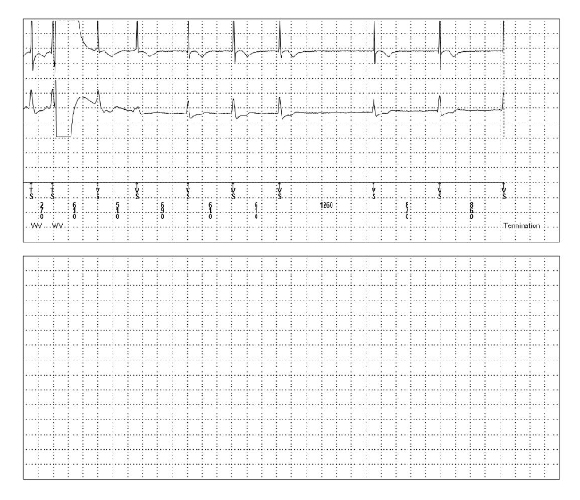
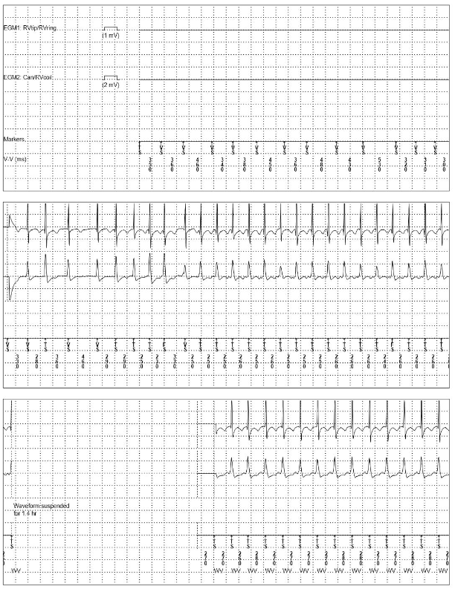
External shock

Slide 12
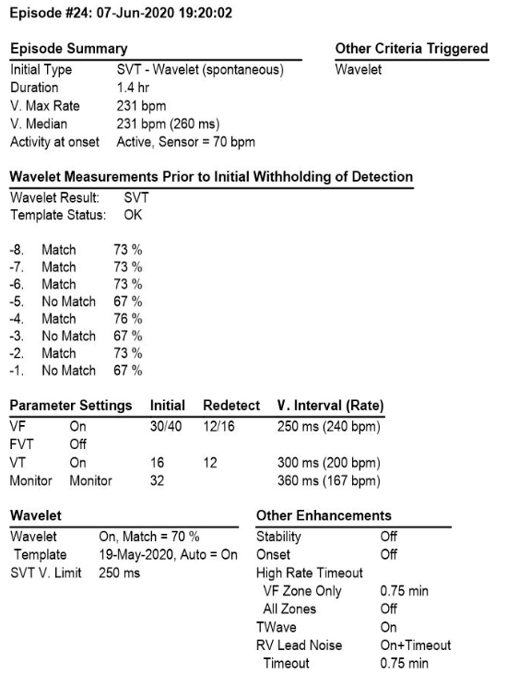
VT vs SVT ?

Slide 13
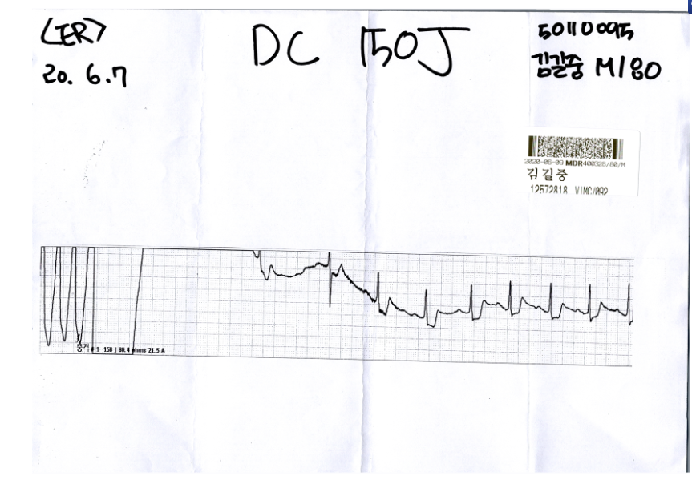
ECG strip during DC cardioversion

Slide 14
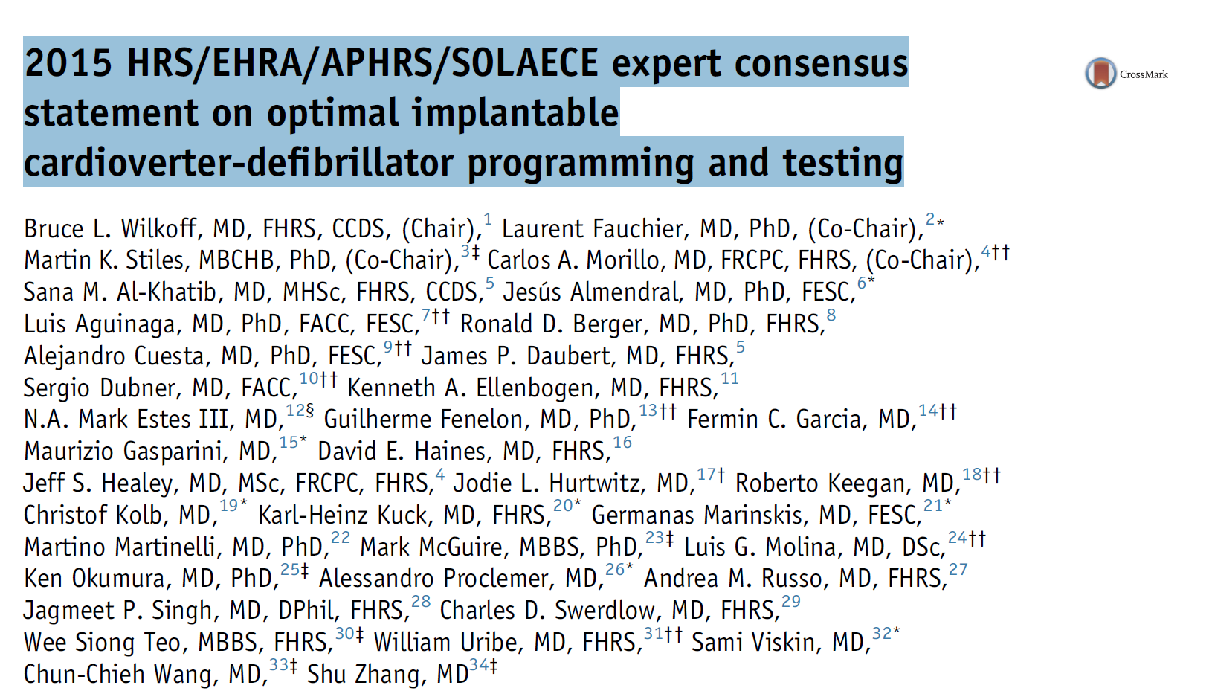
Heart Rhythm 2016;13:e50–e86

Slide 15
Tachycardia detection programming recommendations
1. Let the tachycardia continue.
* Tachycardia detection이 완료되기까지 최소 6-12초, 혹은 30 detection intervals
2. Tachycardia therapy zone의 slowest limit는 185 ~ 200bpm 정도로 정한다.
3. 200~230 bpm 사이에서는 SVT discrimination 알고리즘을 사용한다.
4. Clinical VT rate를 안다면 slowest tachycardia therapy zone을 VT rate보다 10 bpm낮게 설정하는 것이 합리적이다.
5. 2-3개의 tachycardia detection zone을 사용한다.

Slide 16
Tachycardia therapy programming recommendation
ATP가 가능한 기기라면 Shock을 줄이기 위해 ATP 기능을 활용해라.
최소 1회 이상의 ATP (최소 8 stimuli, 84-88% of TCL) 를 시도해라.
Ramp ATP therapy 보다는 Burst ATP therapy를 사용해라.
모든 therapy zone에 shock therapy를 포함시켜라.

Slide 17
감사합니다
Thank you!

